Slide 1
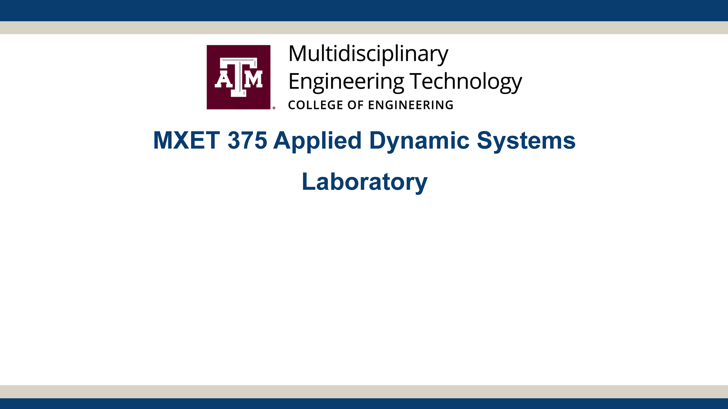
Ball and Beam
Section 906 - Group 27
Kyle Rex, Vadansh Shah, Matthew Travino

Slide 2
Proposal Links
YouTube Video Link:
https://www.youtube.com/watchxxxxxxxxxxxxxxx
Team Folder Link:
https://drive.google.com/drive/folders/1XYHI5zW7jzhonW9jSEi2PNOZHzeOfwnl?usp=drive_link

Slide 3
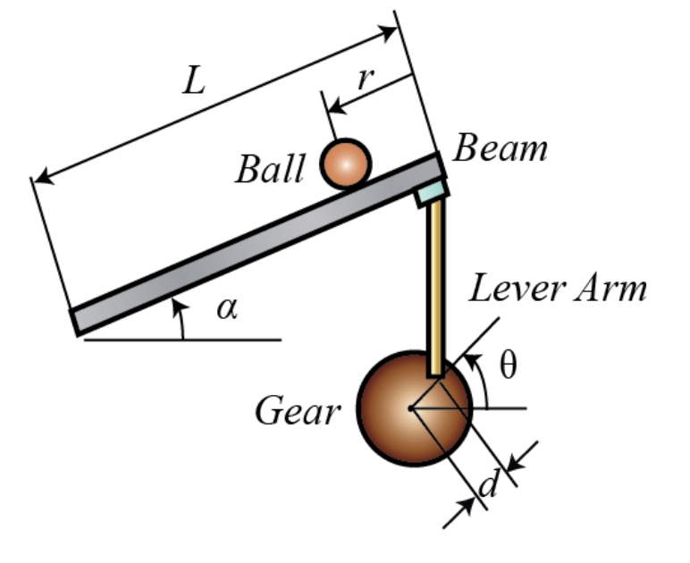
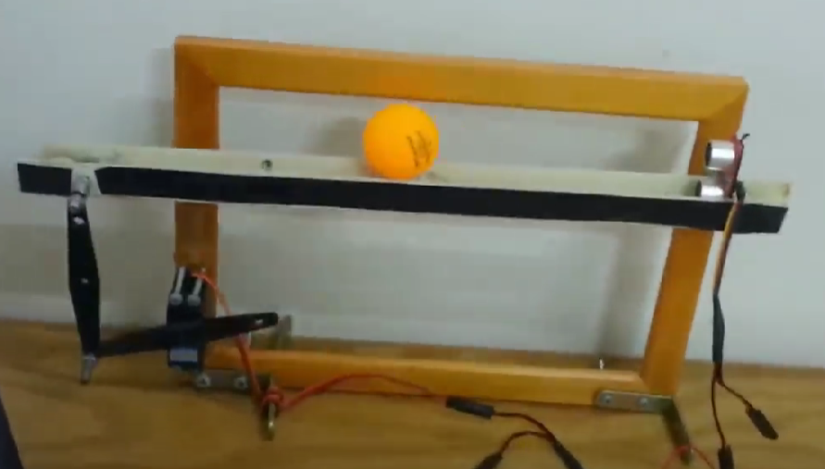
Project Description
A ball is placed on a beam, which can tilt and allows the ball to roll along its length, giving the ball one degree of freedom.
One end of the beam is connected to a lever arm which is connected to another lever arm attached to a servo motor, while the other end of the beam is fixed.
The servo gear rotates by an angle θ, which adjusts the lever arms and causes the beam to tilt by an angle α.
Tilting the beam creates a slope that makes the ball roll due to gravity, depending on the tilt angle.
The goal is to design a controller for this system to control the position of the ball along the beam by adjusting θ.
Project Concept

Slide 4
Plan Of Execution
Mechanical
Build ramp, backboard, and motor arms
Setup motor and sensors
Setup Arduino Uno connections
Electrical & Computer
Create Arduino code to control motor to balance ball
Configure sensor to work
Debug, connect, and complete system
Simulation
Create an initial Simulink simulation to make sure modeling it is feasible
Create final Simulink simulation modeling the complete system
Create an output that shows the change in distance of the ball throughout the simulation

Slide 5
Distribution of Work
Name | Assignments
Kyle Rex | 1. Purchase all materials required for prototype: Motor, Arduino, Sensor, 5V Converter, Joints, and Cardboard.
 | 2. Create the physical initial prototype to be ready for testing: Build ramp, backboard, and motor arms. Setup motor and sensors. Setup Arduino Uno connections.
 | 3. Create MATLAB code to model the distance of the ball throughout the physical demonstration to compare with the output of the Simulink simulation.
Vadansh Shah | 1. Create Arduino code for prototype: Create Arduino code to control motor to balance ball.
 | 2. Configure all parts appropriately to test and make the initial prototype work: Debug, connect, and complete system.
 | 3. Improve initial prototype into a final prototype by improving design where required.
Matthew Travino | 1. Create an initial Simulink simulation to make sure modeling it is feasible.
 | 2. Create final Simulink simulation modeling the complete system.
 | 3. Create an output that shows the change in distance of the ball throughout the simulation trying to get it to match as closely as possible to the physical demonstration result.

Slide 6
Timeline
Task # | TASK TITLE | TASK OWNER | START DATE | DUE DATE | Week 1 |  |  |  |  | WEEK 2 |  |  |  |  |  |  | WEEK 3
 |  |  |  |  | T | W | R | F | S | S | M | T | W | R | F | S | S | M | T | W | R | F | S
1 | title |  |  |  | 9 | 10 | 11 | 12 | 13 | 14 | 15 | 16 | 17 | 18 | 19 | 20 | 21 | 22 | 23 | 24 | 25 | 26 | 27
1.1
1.2
1.3
2
2.1
2.2
2.3
3
3.1
3.2
3.3

Slide 7
Expected Outcomes
Working prototype that balances ball
Complete a working simulation that models the balls movement
Better understand how to model feedback control in mechanical systems

